Slide 1
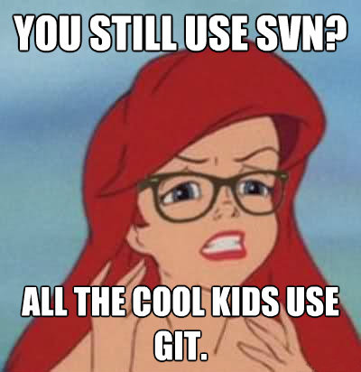
Revision Control with git
Blake Bourque
10/16/15
3pm-6pm
Notes:
How many juniors, hands?
How many seniors, hands?
Not a Junior or Senior?
Who is on schedule with their Sr. Proj?
Who has started writing code?
Making schematics
Designing PCB’s
How are you tracking and backing up your progress?

Slide 2
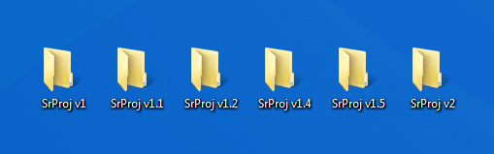

The “Save As…” Method
This is a problem!
Notes:
Who, by a show of hands, has folders like this on their computer?
Who is using dropbox and thinks they are versioned and backed up?
What happens when two people edit the same file?
Who has made a change to their code or design and wished they had a backup?

Slide 3

What is Git?
Noun
an unpleasant or contemptible person.
Proper Noun
a widely used version control system for software development. It is a distributed revision control system with an emphasis on speed, data integrity, and support for distributed, non-linear workflows. Git was initially designed and developed by …
Notes:
Like some ECE professors….
Can anyone complete the sentence?
Anyone read the Wikipedia page?
Git is first and foremost a collection of command-line tools that provide versioning, diffinf/comparision, collaboration

Slide 4
What does git do?
Time Travels
Droboxes
Forking and Un-forking
Oops. Ctrl-Z
Track Changes & lay blame
Backup and Restore
Synchronization & Collaboration
Branching and merging
Undo
Track Changes & Ownership
Notes:
Well It turns out we have a tool called git that is really good at saving us from those pitfalls.
Git has awesome powers, it knows how to time travel, dropbox, undo…..
Git is very good at tracking text files, and just okay at tracking binary files. – Own Slide?

Slide 5
How is git better than […]?
Cheap Local Branching
Everything is local
git is fast
git is small
Staging area
Distributed
Any Workflow
Github
Easy to learn
http://LearnStemLabs.com/articles/whygitisbetter
Notes:
There used to be this great webiste whygitisbetterthanx.com but the domain name expired and it hasn’t been republished

Slide 6
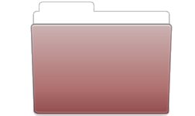
git “areas” Where your code lives
Working Directory
Staging Area
Local Repo
(.git Directory)
Remote Repo
(.git Directory)
(ie. Github)
My Code
git add files
git commit
git push
Notes:
There are a number of “Areas” that git works with.
First: The working directory. This is the directory on your computer where your text editor interacts with your code files.

Slide 7
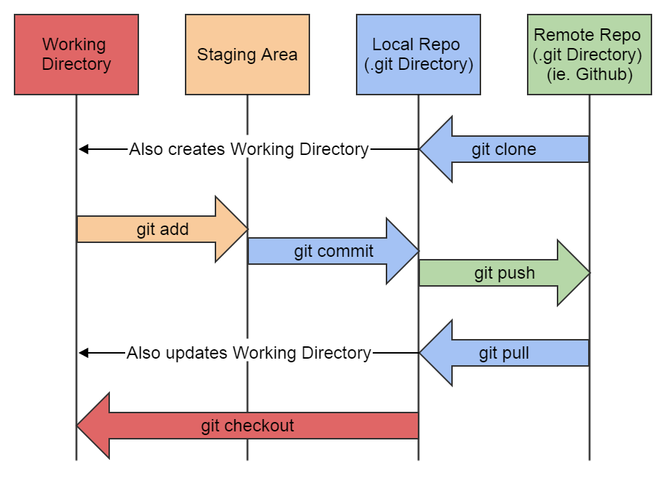
Understanding the a git flow
git clone -or- git init
<make changes>
git add
git commit
git push
git pull

Slide 8
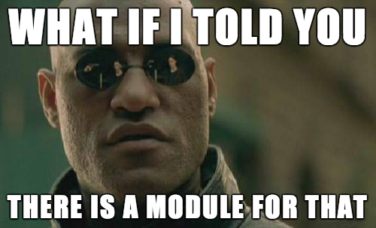
Modules
Getting setup
Time Travel
Type less. Do more.
Branching & Merging
Collaborating
Forking

Slide 9
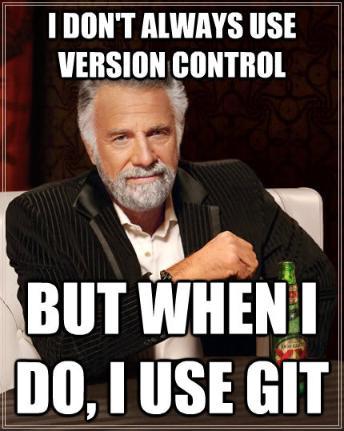
Module 1: Getting Setup
software, accounts and credentials

Slide 10
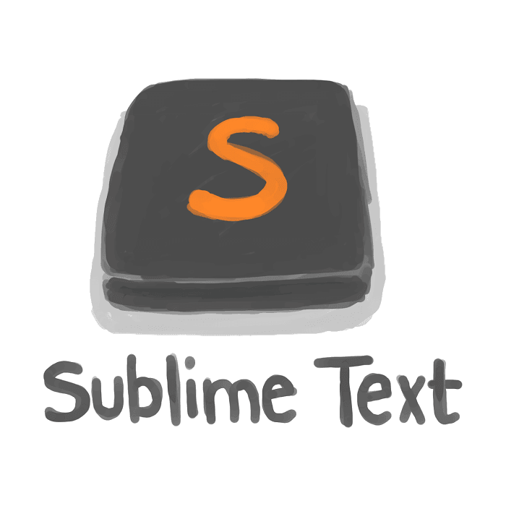
Overview
1
Installing git
Installing gcc
Installing an editor
Configuring git
Configuring vim
Configuring Line Endings
Create a GitHub account
Forge your new identity

Slide 11
Installing git
1.1
Who does not have git installed? Raise your hand in shame!
Linux
apt-get install git -y
yum install git
Mac OSX (use homebrew)
brew install git
Windows (use Cygwin)
http://learnstemlabs.com/articles/

Slide 12
Installing gcc how else would you compile your code?
1.2
Who does not have git installed? Raise your hand in shame!
Linux
apt-get install gcc -y
yum install gcc
Mac OSX (already installed)
gcc
Windows (use Cygwin)

Slide 13
Installing Sublime Text 3 or some other less new-age editor ... vim anyone?
1.3
http://www.sublimetext.com/3
You need package control
https://packagecontrol.io/installation
Highly Recommended Packages
SideBarEnchancements
MarkdownEditing
Installing a package
Ctrl + Shft + P or Cmd + Shift + P
Type: “PCIP” for Package Control Install Package
<package name>

Slide 14

git Configuration
1.4
Tell git who you are
git config --global user.name "Your Name"
git config --global user.email your_email@whatever.com
Tell git what editor you want to use for commit messages
git config –global core.editor vim
Tell git that you would like to see pretty colors
git config color.ui auto

Slide 15
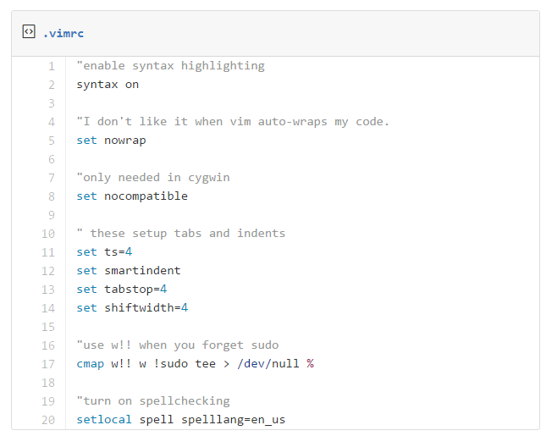
vim Configuration
1.5
http://git.io/vCIBR

Slide 16
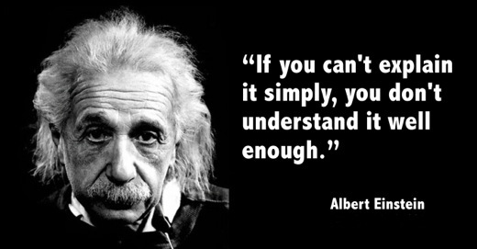
Line Ending Preferences why can’t we all just agree and be friends
1.6
Unix/Mac users:
git config --global core.autocrlf input
git config --global core.safecrlf true
And for Windows users:
git config --global core.autocrlf true
git config --global core.safecrlf true
Notes:
http://adaptivepatchwork.com/2012/03/01/mind-the-end-of-your-line/

Slide 17

Create a GitHub account or bitbucket or gitlab
1.7
Go to github.com / bitbucket.com / other
Create account
Profit!
Notes:
http://adaptivepatchwork.com/2012/03/01/mind-the-end-of-your-line/

Slide 18
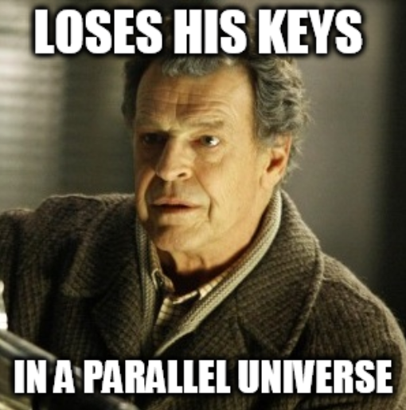
Forge your new identity ssh key identity that is
1.8
https://help.github.com/articles/generating-ssh-keys/
Google: github ssh
Make sure to add your public key to your account
Understanding public key cryptography
Public / Private key pair
The public key decrypts that encrypted by the private key
The private key decrypts that encrypted by the public key
Everyone can encrypt with the public key, only the private key holder can decrypt
That encrypted with the private key can be decrypted with the public key, since the private key is private, the decryptor can verify the payload is from a known encryptor
Notes:
Github has a great article on generating your public / private key pair that changes based on your OS, its great!
http://stackoverflow.com/questions/5898940/how-works-public-key-cryptography-on-github

Slide 19
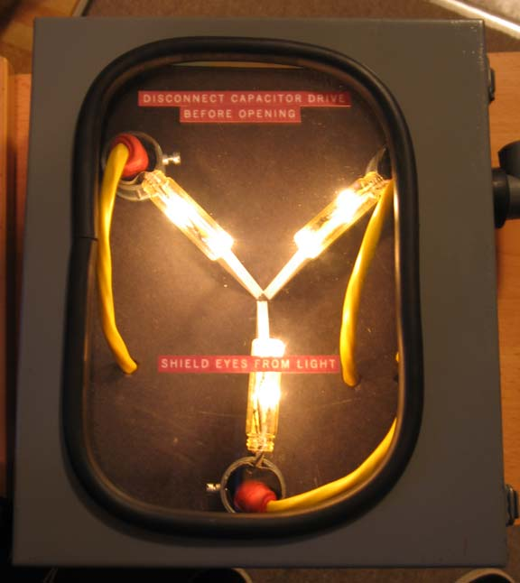
Module 2: Time Travel
backup, restore and view code versions

Slide 20
Creating History Overview
2
Creating a working directory ........... ( $ mkdir files )
Initializing the repository .............. ( $ cd files $ git init )
Checking the status! ..................... ( $ git status )
Create a readme
Adding to the staging area .............. ( $ git add . )
Committing staged changes ............ ( $ git commit )
Starting to Program
Ignoring (compiled) files ................ ( $ vim .gitignore )
Checking the status! ..................... ( $ git status )
Making more changes
Stage & Commit .......................... ( $ git add . $ git commit )
Partial stage & globing .................. ( $ git add -p . )
Reverting History

Slide 21
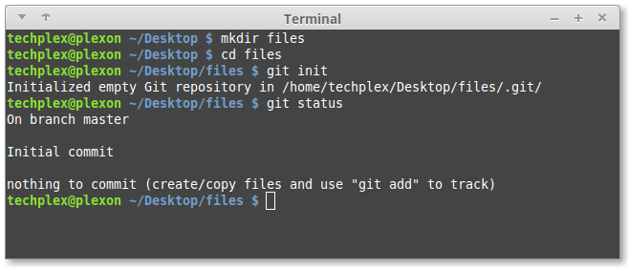
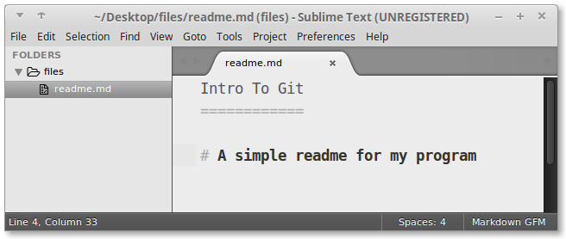
Creating History Starting
2.1
Creating a working directory ........ ( $ mkdir files )
Initializing the repository ........... ( $ cd files $ git init )
Checking the status! .................. ( $ git status )
Create a readme
Notes:
Call attention to “on branch master”

Slide 22
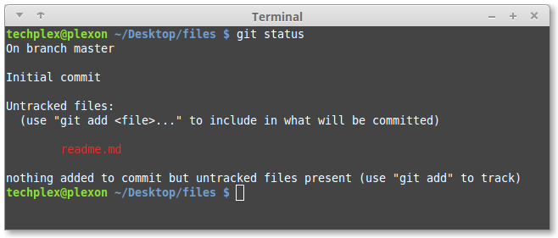
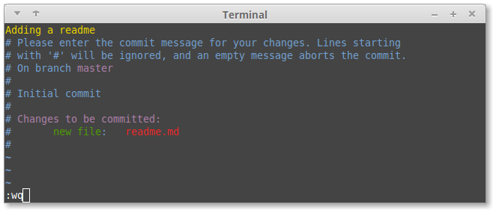
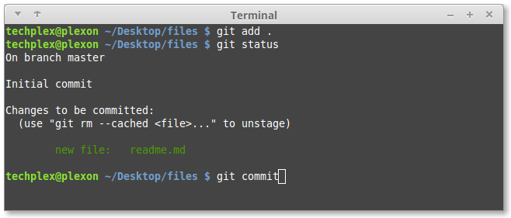
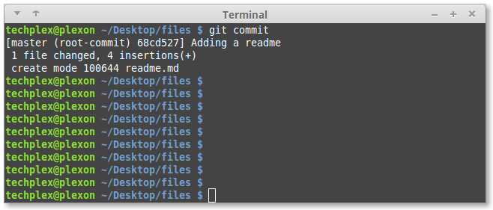
Creating History Staging & Committing
2.2
Checking the status! ............. ( $ git status )
Adding to the staging area ...... ( $ git add . )
Committing staged changes ..... ( $ git commit )

Slide 23
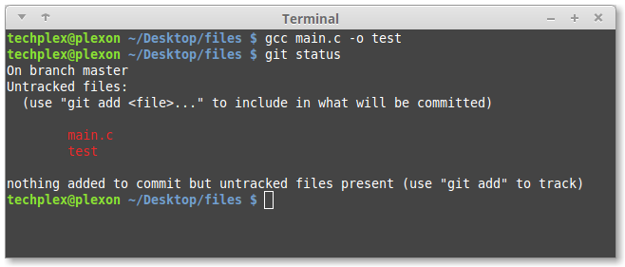
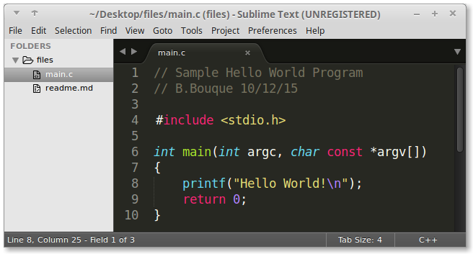
Creating History Programming
2.3
Starting the Program
Compile the program

Slide 24
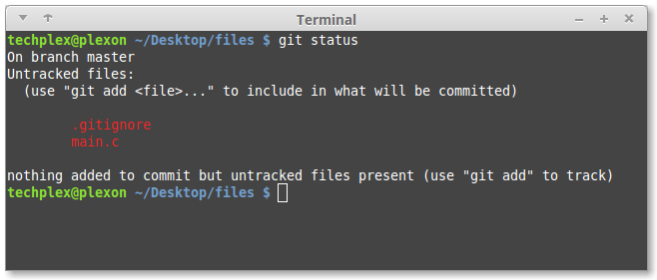
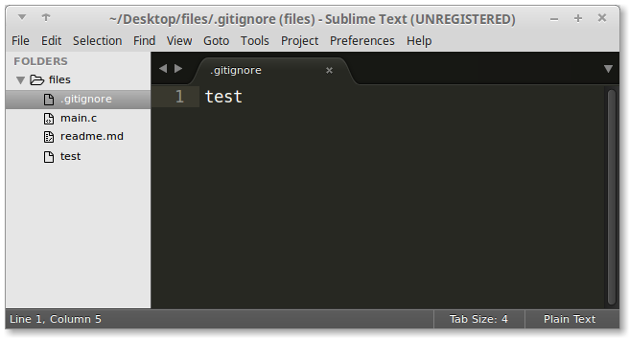
Creating History Ignoring
2.4
Ignoring (compiled) files ... ( $ vim .gitignore )
Checking the status! ........ ( $ git status )

Slide 25
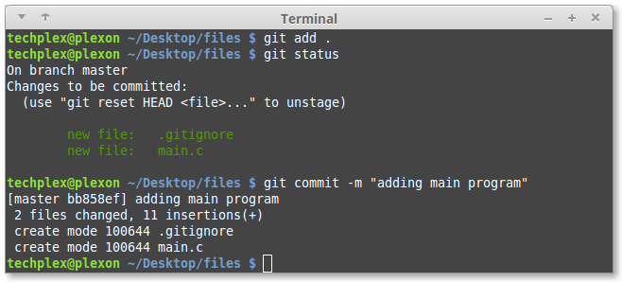
Creating History Committing
2.5
Stage & Commit ........................ ( $ git add . $ git commit )

Slide 26
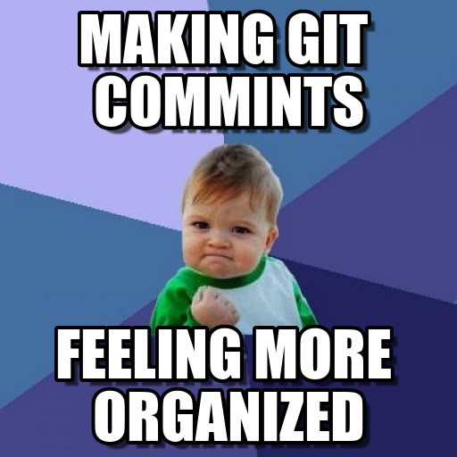
Creating History More Committing
2.6
Adding more code
Partial stage & globing .......... ( $ git add -p . )
Commit ............................ ( $ git commit )
Notes:
This time make a mestake
We’ll revert it shortly

Slide 27
Reverting History
2
Don’t forget about undoing local changes
git checkout HEAD file(s)
git checkout HEAD^ file(s)
HEAD = The current tip of the master
HEAD~ = First parent of the tip of master
HEAD~2 = First parent of the First Parent of the tip of master
HEAD~2
HEAD~
HEAD~1
HEAD
Master
Notes:
There are a lot of ways to revert history. In my opinion this is the clearest and safest.

Slide 28
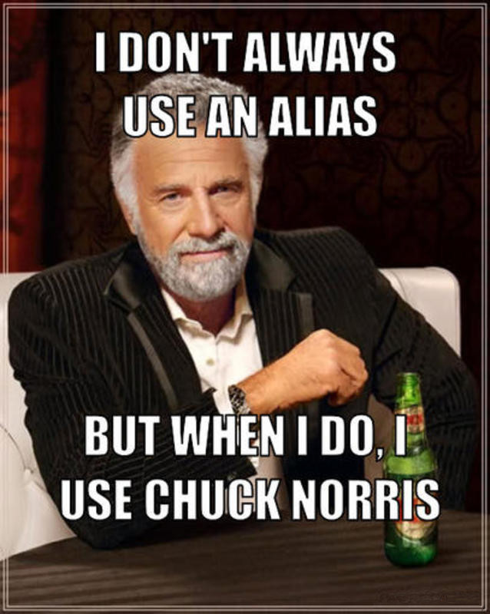
Module 3: Type less. Do more.
git-number and aliases

Slide 29
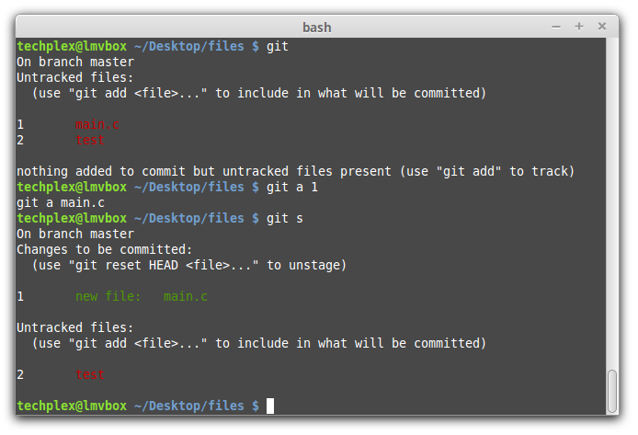
Type Less. Do More. The magic of git-number
3.1
Download git-number from github http://git.io/vCIWL
Copy the three programs onto your path
git-id
git-list
git-number
Alias git to git-number (add to .bashrc)
alias git='git number -c git‘
relog

Slide 30
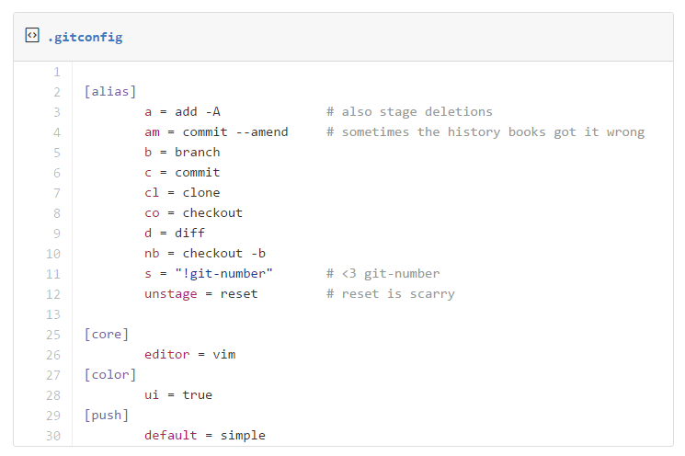
Type Less. Do More. Making aliases for fun and profit
3.2
http://git.io/vCIBR
Notes:
Some of my favorite aliases and config. Notice editor=vim remember setting our editor earlier?
http://gitimmersion.com/lab_11.html
hist = log --pretty=format:'%h %ad | %s%d [%an]' --graph --date=short

Slide 31
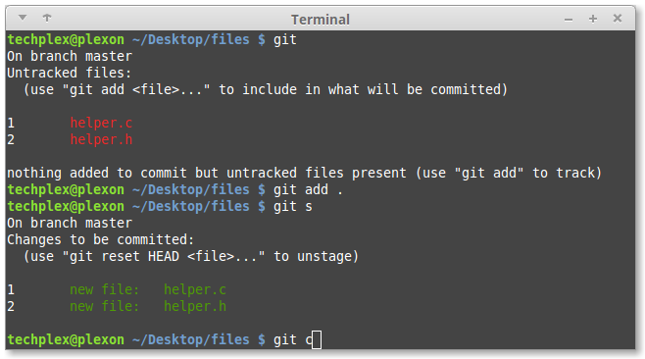
Type Less. Do More. Using aliases for fun and profit
3.3

Slide 32
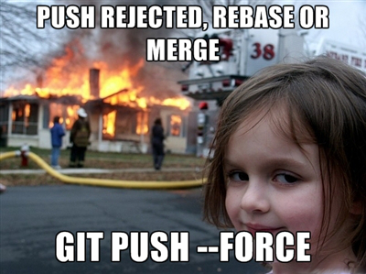
Module 4: Branching & Merging
DON’T
DO
THIS!
Type less. Do more.

Slide 33
Creating branches
4.1
Git nb branch_name
Git checkout –b branch_name
Git branch branch_name
Git checkout branch_name
Notes:
NOTE: git checkout -b <branchname> is a shortcut for git branch <branchname> followed by a git checkout <branchname>.
Notice that the git status command reports that you are on the ‘greet’ branch.
http://gitimmersion.com/lab_24.html

Slide 34
Navigating branches
4.2
Git checkout master
Git status
Git checkout branch_name
Show the working directory
Notes:
NOTE: git checkout -b <branchname> is a shortcut for git branch <branchname> followed by a git checkout <branchname>.
Notice that the git status command reports that you are on the ‘greet’ branch.
http://gitimmersion.com/lab_24.html

Slide 35
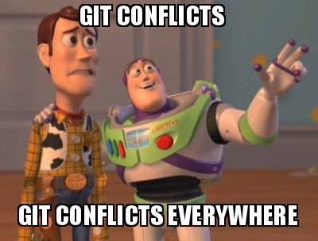
Merging a branch
4.2
“Clean” merging
Dealing with conflicts
Notes:
My advice: communicate as to avoid conflicts

Slide 36
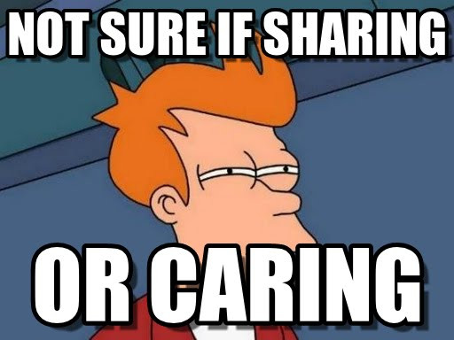
Module 5: Collaborating

Slide 37
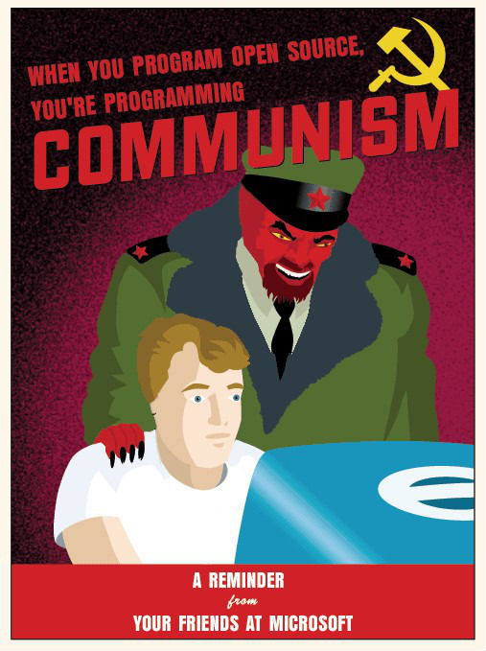
Collaborating Using Github
5.1

Slide 38

Module x: Tricks & Treats

Slide 39
Submitting Logs for Senior Project
x
Use tags each time you output your logs
Here is the command:
Use enscript here is how to set header
http://git.io/vCV4U

Slide 40
Resources
http://gitimmersion.com/

